Slide 1
Action Groups What do they do? …& How do they do it?

Slide 2
An presentation from an action group from Whittington Village & Lichfield City
Formed on September 2010 following publication of ‘the preferred route’…
…located at the end of Phase 1 of HS2

Slide 3
Action Groups… What do they do?
Actively spread the message
and generate support
to 'oppose the principle of HS2’

Slide 4
Unite communities and creating wider support for the campaign nationally.
Strive for inter-group unity....avoid disharmony
United we stand...divided we fall.

Slide 5
How do they do it?...

Slide 6
Action Groups position within the 'National Structure'
AGAHST
Action Groups Against HS2
Action Groups

Slide 7
Getting Started...
Define your boundary...you can always extend!
Define a base...parish councils should support
Be prepared to share and grow organically with neighbouring groups
'All Support Welcome' policy...
…recruiting varying skill sets are the key and be prepared for varying levels involvement

Slide 8
Monthly Public Meetings
Keep the impetus up!
…and your meeting frequency consistent
(We meet on a monthly basis)
We always ‘Welcome’ and define the groups principle 'opposition to the principle of HS2’
at the start of every meeting to remind attendees (new and old) of our ultimate purpose.

Slide 9
Recruit!...
Pass round an attendance sheet to collect data
…and invite attendees to give you their email address.
(Action Groups are limited by their time and resources!)

Slide 10
Record!...
Designate a notes keeper for resulting action points
…and invite attendees to volunteer accordingly.

Slide 11
Monthly meetings agenda…
Keep a simple but informative agenda... eg:
Local issues
National Issues
Events and Fundraising
Notices & AOB

Slide 12
…and then very importantly…The social side!
Perhaps Tea & Coffee at the end
….or patronage at the local boozer!

Slide 13
Generate an Email database of active supporters...

Slide 14
Then, Email your database of active supporters with activities they can engage...
Remember, best practice…
Use Email but don't abuse peoples inbox patience! (One email a week is enough!)
‘Bcc’ members so as to protect list and individual identities.
Consider data protection….
“We won’t pass on your email to anyone and will remove you from our databse if requested”

Slide 15
Use the StopHS2 & HS2AA websites for sources of activity …
www.stophs2.org www.hs2actionalliance.org

Slide 16
And don’t forget…the viable alternative to HS2…
www.betterthanhs2.org

Slide 17
Action group 'Team' meetings
(I'm not a fan of the word 'Committee’ but that’s essentially what we feel a group needs!)
If possible or group size allows, try and construct a group structure….
Roles can overlap but here’s the example our group structure…

Slide 18
A Chairman...a mediator to keep 'meetings' moving...don't feel there needs to be a 'leader’
A ‘Scribe’ – to keep account of action points or volunteers
Group Contact / liaison with 'National' or AGAHST

Slide 19
PR - Press relations...somebody who can keep feeding developments or facts about the campaign to local/regional press and newspapers
Web and Email manager...someone to build or update your website and send group emails
Financial Secretary...someone to account for monies.
Fundraisers / Event organisers

Slide 20
..other useful 'Team' members
If volunteers exist other useful roles…
Environmentalists
Civil Engineers
…or train experts!

Slide 21
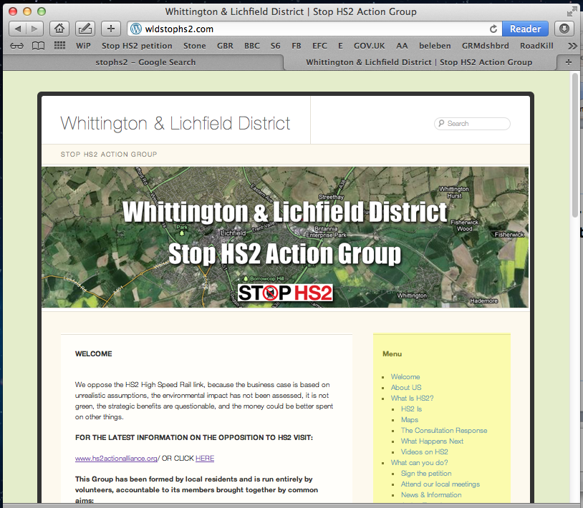
Using the internet...
Build a simple website for notices, news, links and local information relevant to your group….
Try 'wordpress.com’
....it’s free and easy to set up..
www.wldstophs2.com

Slide 22
Don’t forget…much of the information or news you’ll require can be lifted from or linked to pages at…
www.stophs2.org www.hs2actionalliance.org

Slide 23
Social Media...
Facebook... create a local facebook page
….and connect to STOP HS2!
Twitter...follow and re-tweet HS2 campaigners...tweet your opposition

Slide 24
Who can you ask for help from?
Parish Councils
District Councils
County Councils
Affected landowners and business.

Slide 25
1. Parish Councils (PC)
Enlist or recruit a suitable Parish Councillor
Ask for use of PC facilities for a ‘Community Event’
Ask your PC about a ‘Section 137’ grant for a Community Project.

Slide 26
2. District Councils
Grants and support should be available
Engineers and expertise
….They should appoint a representative!

Slide 27
3. Your County Council
Grants and support
Engineers and expertise
…They should appoint a representative too!
…and Join 51M if they haven’t already!

Slide 28
4. Affected landowners & business
Some may be able to give just time
Some may be able to give just money
…& some both!

Slide 29
Local signage
inform the community know you exist!
Raise awarenes of the route
if it’s passing through
your area.

Slide 30
Lobby at HS2 Ltd Consultation events.
Have a presence and highlight the justified opposition.
at your local community events…spread the word!

Slide 31
Action Groups will be invited to attend...
Community Forums & Bi-laterals...meetings with HS2 Ltd
Council meetings relating to development in your area.
(Keep friends close and enemies closer!)

Slide 32
Engaging Mitigation…
All part of the overall opposition battle…
…HS1 proved there is only a finite window of opportunity to register mitigating detail.
Mitigation may well drive the cost of HS2 and highlights justified objection and recording your involvement may assist in legal action against HS2 Ltd for failures and misinformation!

Slide 33
Why Fundraise?...
Support National legal and lobbying costs.
To pay for costs you'll incur...(eg: signage, event running, promotional collateral, signage)
Support Hilary and HS2AA & or Joe at STOPHS2... plus others who will no doubt materialise as the battle goes on!

Slide 34
Keep the ‘Fun’ in Fundraising…
…your group will gain popularity, new recruits and strength too!

Slide 35
Fundraising events
Outdoor Shows in your area...
Fetes and Countryside Field events..
Social Events…Disco’s and gatherings that openly generate funds and generate fun!
A few simple ideas that worked for us…

Slide 36
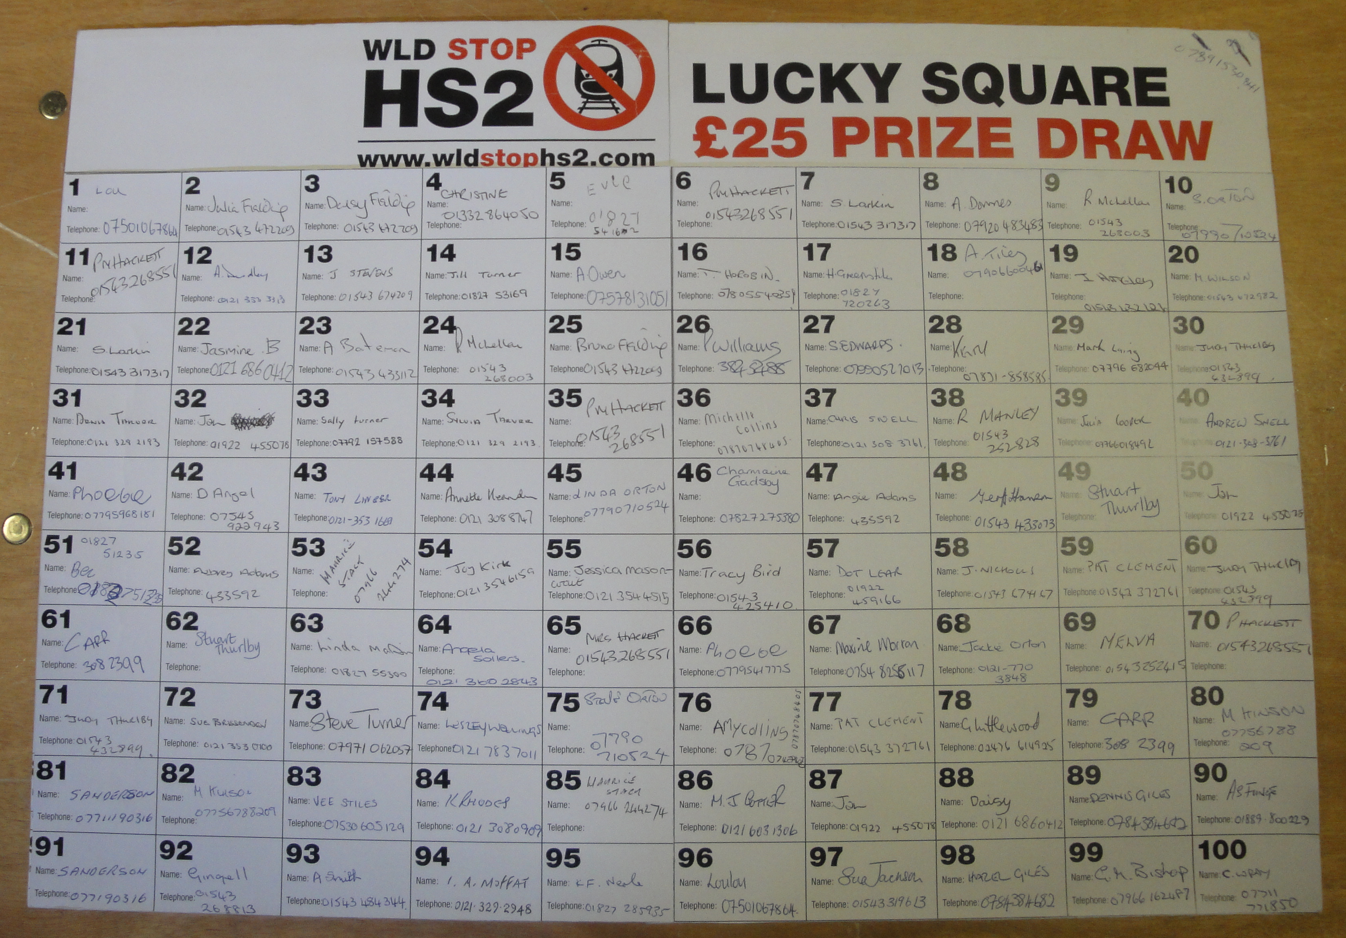
Fundraising ideas…
Numbers Boards... 100 squares draw, £1 per number, winner receives (say) £25…!

Slide 37
Fundraising ideas…
Balloon races...great for press coverage...and spreading the word off the line.
(Most balloons are made from natural latex so not too environmentally damaging!)

Slide 38
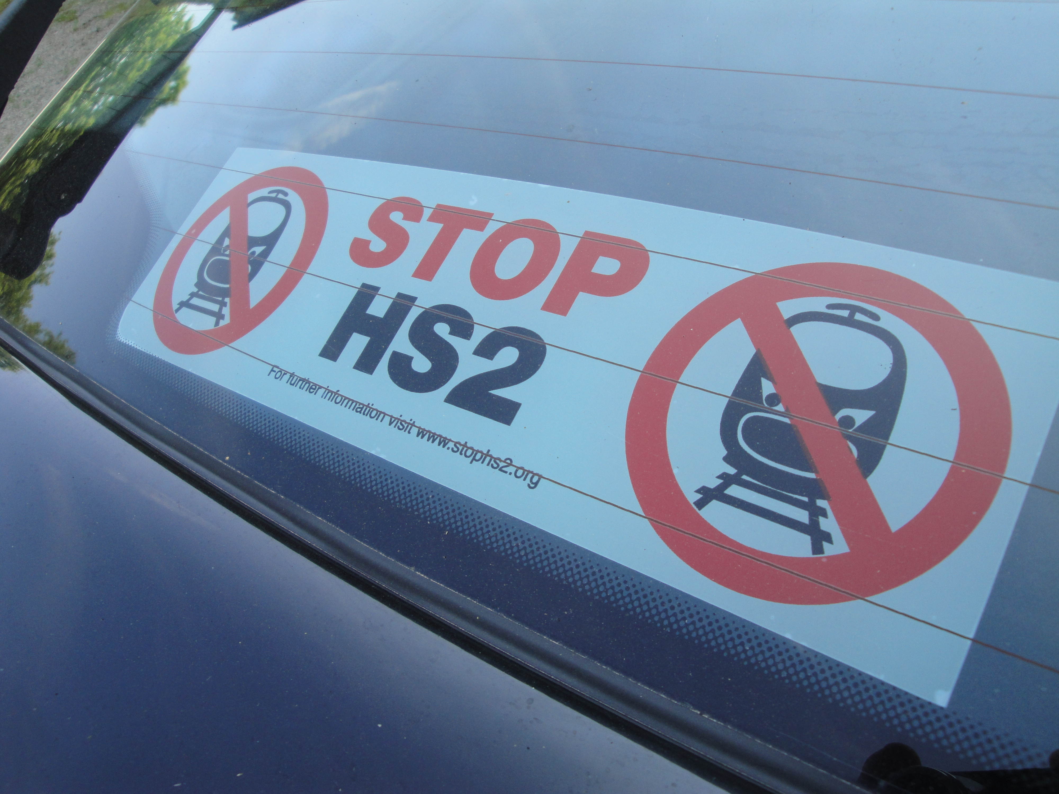
Fundraising ideas…
Sell Car Stickers...'Stop HS2'...great adverts for awareness….

Slide 39
Fundraising ideas…
Get the T-Shirt!
…add your Website
to promote
Your group!

Slide 40
Remember….Use the StopHS2 & HS2AA websites for resources, assets, facts to share and as your source of information…
www.stophs2.org
www.hs2actionalliance.org
www.betterthanhs2.org
You’re not alone!

Slide 41
Be positive, be strong & unite...
…this battle could run for some time!
But if we don't fight,
we'll never know what we could have achieved.
Thank you & Good Luck.

